Slide 1


Slide 2

Data Analysis of University Students' Preferences and Behavior
Multi-Output Prediction
This presentation explores student behavior using advanced multi-output techniques. Multi target classification.
This strategy consists of fitting one classifier per target. This is a simple strategy for extending classifiers that do not natively support multi-target classification.
By Nathan Jude Furtado

Slide 3

Introduction to the Dataset
Dataset Context
Collected survey responses detailing student’s university experiences, activity & lifestyle
Key Questions Explored
Would you recommend your university to others.
Are you satisfied with the university’s facilities.
Do you prefer online classes over offline classes.
Do you live in a hostel.

Slide 4
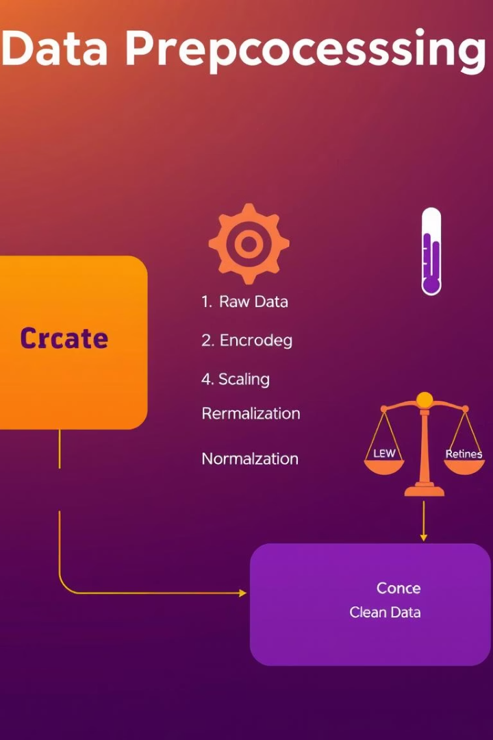



Data Preprocessing Techniques
Categorical Encoding
One-Hot Encoding
Feature
Scaling
Converting Yes/No categories into numerical formats.
Eg:df.replace({'Yes':1,'No':0,'yes':1,'no':0})
Applied to variables like gender and degree type for model compatibility.
Eg: pd.get dummies
Normalization ensures balanced influence of variables in the model.
Eg: StandardScaler

Slide 5
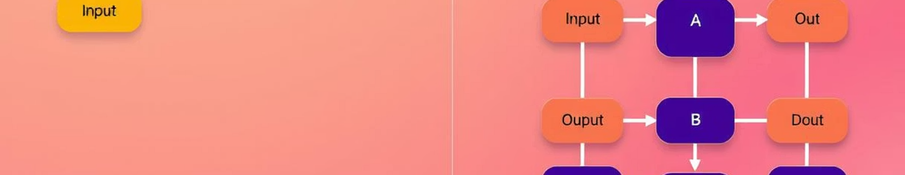
Multi-Output Model
Model Type
Purpose
Advantages
Multi-output extension of Logistic regression, Artificial Neural Network, Random forest, and Support Vector Machine.
Predicts several student preferences and behaviors simultaneously.
Efficient handling of correlated output variables in one model.

Slide 6
Multi-Output Model
1
Logistic Regression
2
Artificial Neural Network
3
Random Forest
4
Support Vetor Machine
The LogisticRegression() is a logistic regression model from scikit-learn, used for binary or multiclass classification.
MLPClassifier() is a feedforward artificial neural network that maps input data to outputs through one or more hidden layers using backpropagation.
RandomForestClassifier() is an ensemble learning model from scikit-learn based on decision trees. It’s widely used for both classification and regression due to its accuracy and robustness.
RandomForestClassifier() is an ensemble learning model from scikit-learn based on decision trees. It’s widely used for both classification and regression due to its accuracy and robustness.

Slide 7
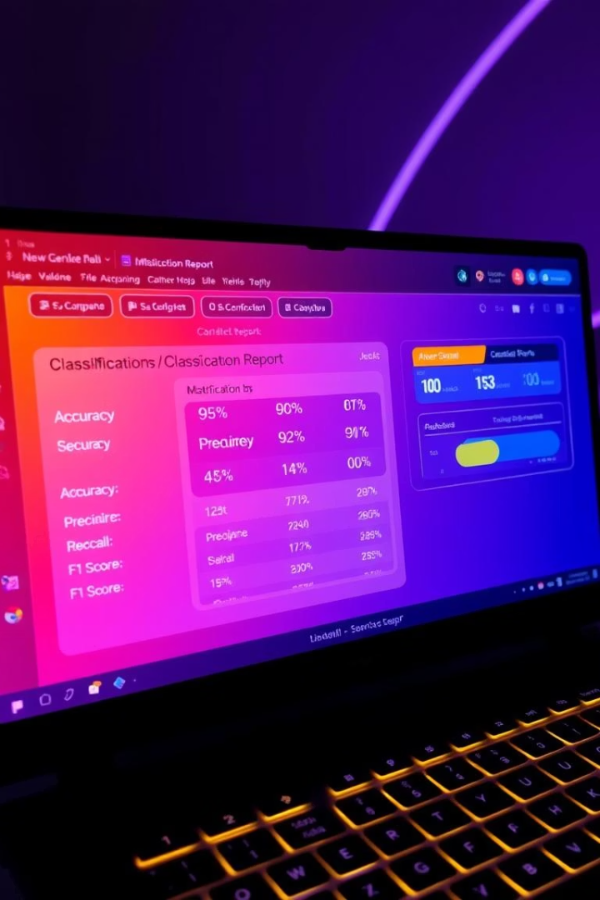
Model Evaluation Metrics
Accuracy
Measures overall correct predictions proportion.
Precision & Recall
Evaluate false positives and false negatives respectively.
F1-Score
Balances precision and recall for robust performance assessment.

Slide 8
Key Insights from Predictions
Would you recommend your university to others.
Do you prefer online classes over offline classes.
Do you think the university should offer more extracurricular activities.
Do you live in a hostel.

Slide 9

Conclusion and Recommendations
1
Summary
2
Policy Implications
3
Future Work
Model identified behavior and preference patterns among students.
Encourage more extracurricular offerings, especially.
Improve model with features and data.

